Slide 1

RAISING YOUR SELF-ESTEEM
Hal Baumchen, PsyD, LP, LADC

Slide 2
In This Chapter
Examine the influence of self-esteem
Discover what self-esteem is and is not
Explore ways to increase self-esteem

Slide 3

What is Self-Esteem?
Self-esteem is simply how you see yourself.
Healthy self-esteem is feeling positive about yourself, being appropriately assertive, and acting with confidence. It includes being resilient and having an overall sense of well-being.

Slide 4

SELF ESTEEM IS NOT:
Being perfect
Never making a mistake
Always winning or being first
Having more than others
Being an ideal weight
Always being happy
Having everyone’s approval
Always being noticed
Never being noticed
Being good at everything
Always being calm
Looking good
Being better than others

Slide 5

A POSITIVE SELF-CONCEPT
Because we act and feel according to how we see ourselves, a healthy self-concept is important. If we see ourselves as adequate, influential, and valuable we will act confidently, talk to others freely, and express our opinions openly.

Slide 6
A POSITIVE SELF-CONCEPT
If we see ourselves as inadequate and inferior, opinions are withheld, other people avoided, and new friendships approached with caution.

Slide 7

Distortions AND MISPERCEPTIONS
Self-esteem is shaped by our own self-perceptions, thoughts, and past experiences.

Slide 8
Distortions AND MISPERCEPTIONS
Trauma, especially an emotionally or physically abusive childhood or sexual abuse, can add to feelings of inadequacy and leave someone feeling damaged. Self-concept is often more related to internal self-perception than external appearance.

Slide 9
Distortions AND MISPERCEPTIONS
Your value is not determined by what others think of you.

Slide 10

Understanding self-Worth
Low self-esteem will keep you from valuing your own ideas and opinions. Poor regard for your worth may make it difficult to receive compliments for a job well done.

Slide 11
Understanding self-Worth
Weaknesses and faults can be blown out of proportion, while skills and abilities are underestimated.

Slide 12
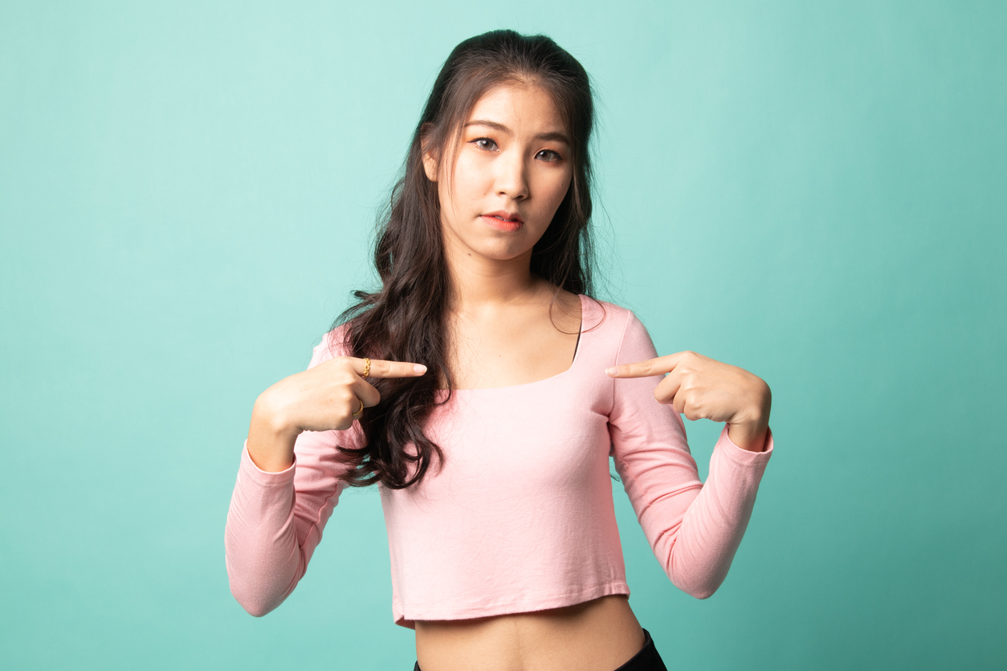
Influential Factors That
Shape Self-Esteem
Many factors shape and influence your self-esteem and its development, beginning in early childhood. These can include:
Your own thoughts and perceptions
How others respond and react to you
Experiences at school or work
Being compared unfavorably to others

Slide 13
Influential Factors That
Shape Self-Esteem
Many factors shape and influence your self-esteem and its development, beginning in early childhood. These can include:
Religious views of family or community
Traumatic experiences such as physical, sexual, emotional, or verbal abuse
Cultural view toward you

Slide 14
Influential Factors That
Shape Self-Esteem
Many factors shape and influence your self-esteem and its development, beginning in early childhood. These can include:
Community attitudes toward you
Having a chronic illness
Having an injury or disability

Slide 15

Role and Status in Society
Relationships with those close to you, especially parents, siblings, peers, teachers, and other important contacts, are very important to your self-esteem.

Slide 16
Role and Status in Society
Many beliefs you hold about yourself reflect messages received from these people over time.

Slide 17
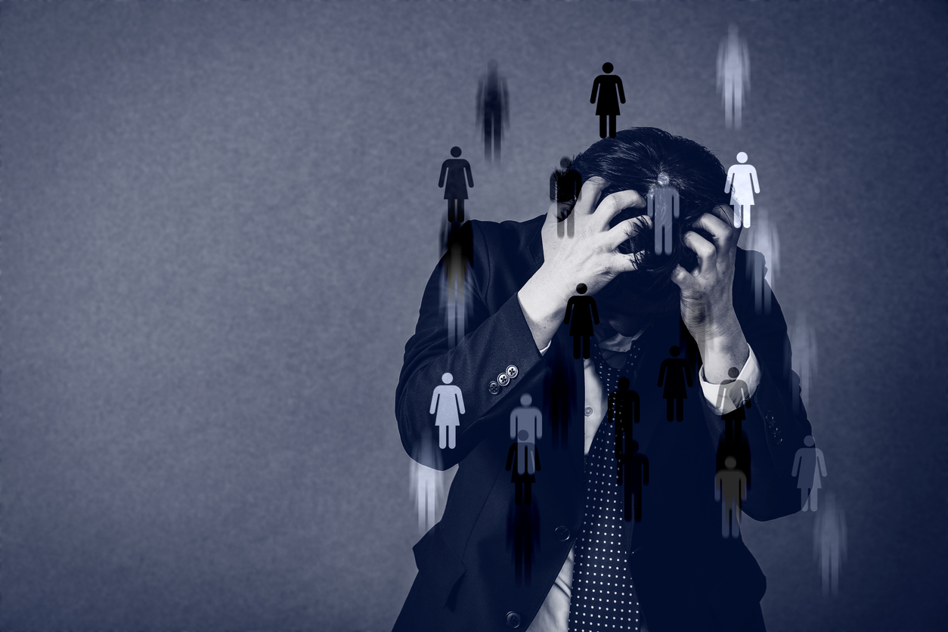
Role and Status in Society
Still, the biggest impact on self-esteem comes from your own thoughts, which puts you in control. If you tend to focus on your weaknesses or flaws, you can learn to re-frame negative thoughts and instead concentrate on your positive qualities.

Slide 18
Role and Status in Society
How have others damaged how you view yourself?
How have your perceptions of yourself affected you in negative ways?
How have your perceptions of yourself affected you positively?

Slide 19
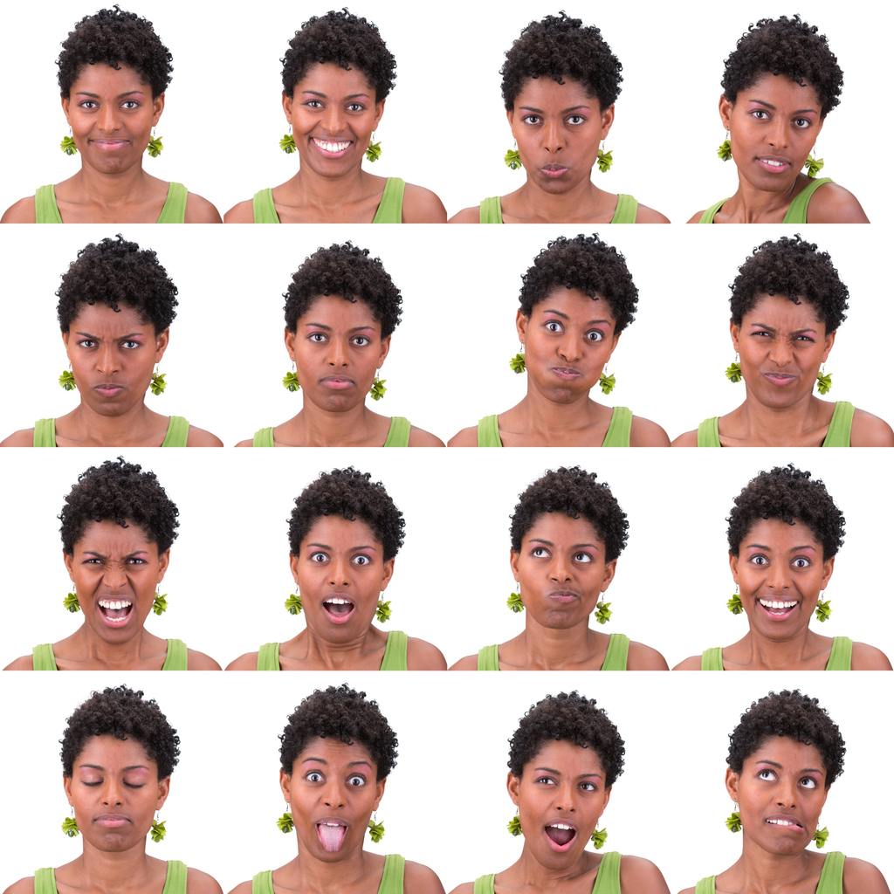
The Ranges of Self-Esteem
Depending on your circumstances, self-esteem will fluctuate over time. It is normal to have times you feel down about yourself and judge yourself unfavorably. And there will be times you feel especially good.

Slide 20

Overly High Self-Esteem
Those with overly high self-esteem regard themselves very highly and have an unrealistically positive view of themselves. An inflated self-esteem makes them feel superior to others and can lead them to be arrogant, self-absorbed, and self-indulgent.

Slide 21
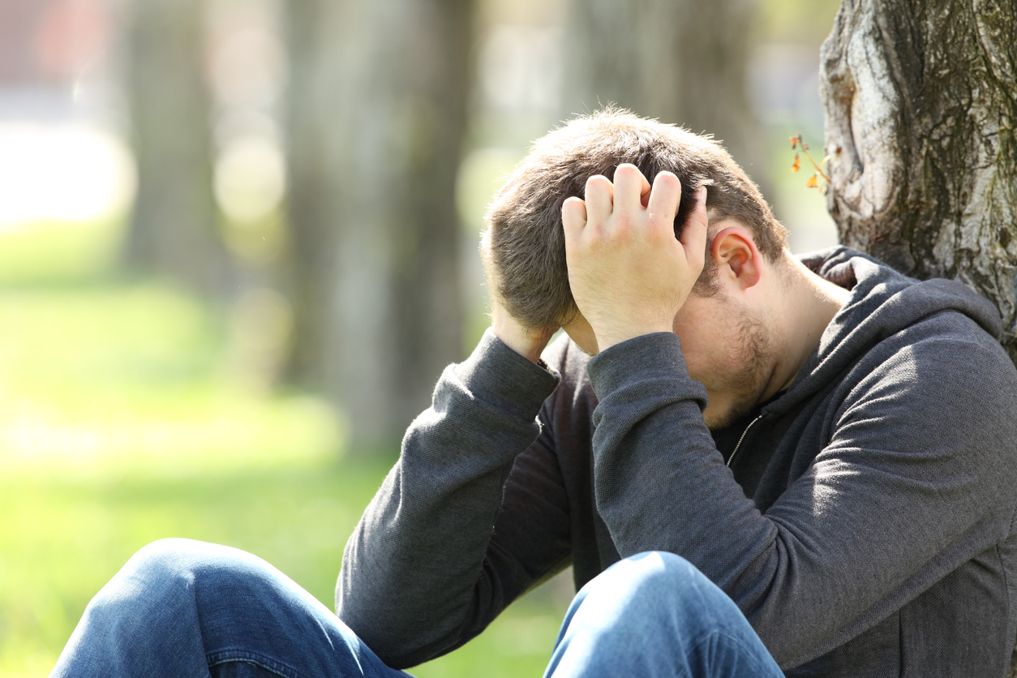
Low Self-Esteem
Low self-esteem can lead to chronic indecision, insecurity, perfectionism, hostility, guilt, pessimism, and jealousy.

Slide 22
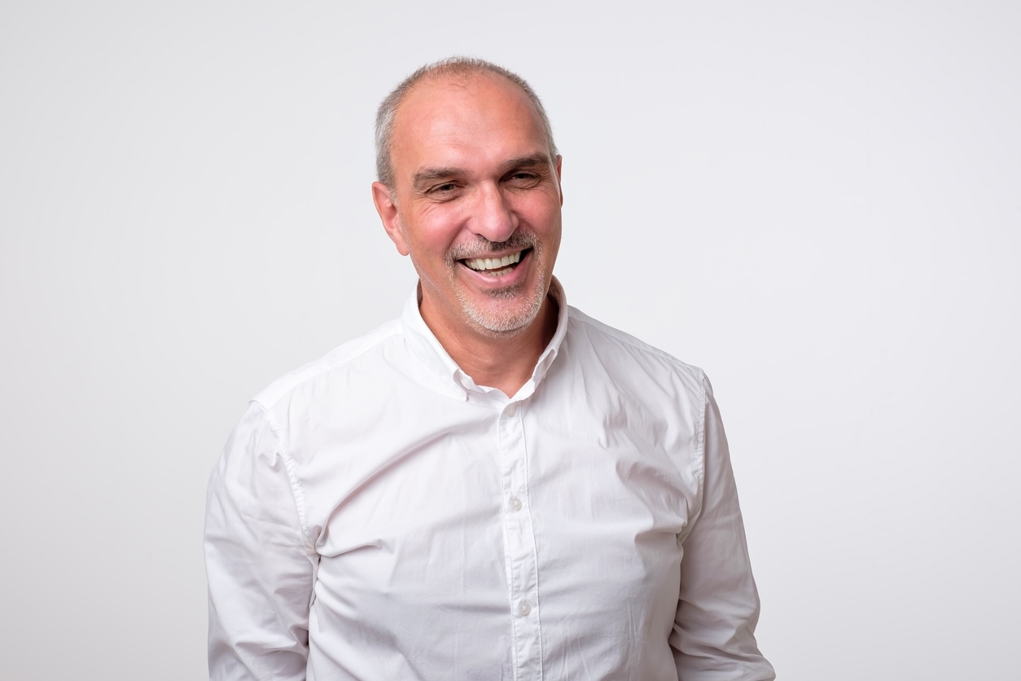
Healthy Self-Esteem
Healthy self-esteem lies between these two extremes. It means having a balanced, accurate view of yourself, a good opinion of your abilities, and healthy recognition of your flaws.

Slide 23
Healthy Self-Esteem
When you value yourself and have good self-esteem, you feel secure, worthwhile, and generally have positive relationships with others.

Slide 24
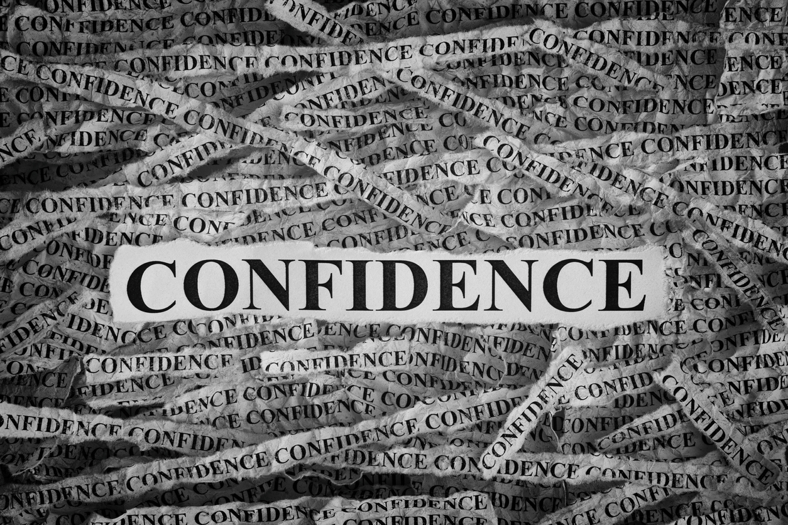
Those with healthy self-esteem tend to be:
Appropriately assertive in expressing needs and opinions
Confident in their ability to make decisions
Able to build secure and honest relationships and are less likely to stay in unhealthy ones
Less prone to feeling hopeless, worthless, or full of guilt and shame

Slide 25
Those with healthy self-esteem tend to be:
Realistic in their expectations and are not overly critical of self and others
More resilient and better able to weather stress and setbacks
Less likely to develop an addiction or mental health condition such as depression, anxiety, or an eating disorder

Slide 26
Those with healthy self-esteem tend to be:
Realistic in their expectations and are not overly critical of self and others
More resilient and better able to weather stress and setbacks
Less likely to develop an addiction or mental health condition such as depression, anxiety, or an eating disorder

Slide 27
The Key:
The key to healthy self-esteem is not to think less of yourself but instead to think of yourself less.
Focus on others and not only on yourself.

Slide 28
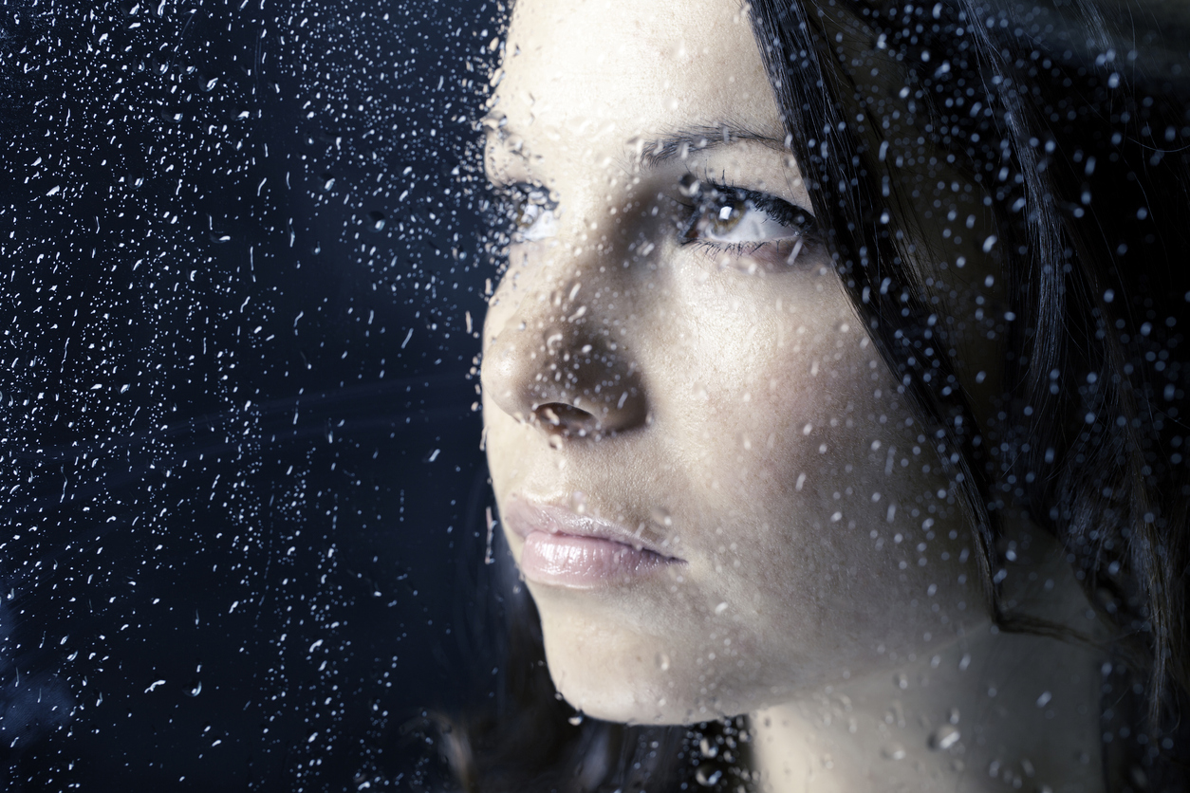

LOW Self-Esteem Checklist
For many people a struggle with low
self-esteem is lifelong. Do you:
Avoid eye contact with others
Find it difficult to start conversations
Have trouble making up your mind or making a decision
Have trouble expressing how you feel
Not feel confident

Slide 29
LOW Self-Esteem Checklist
For many people a struggle with low
self-esteem is lifelong. Do you:
Rarely express your opinion in a group
Feel embarrassed about how you look
Have difficulty asking for what you need or want
Feel tense around most people

Slide 30
LOW Self-Esteem Checklist
For many people a struggle with low
self-esteem is lifelong. Do you:
Often worry about what others think of you
Not feel others approve of you
Think life lacks purpose and direction

Slide 31

LOW Self-Esteem Checklist
For many people a struggle with low
self-esteem is lifelong. Do you:
Worry about saying or doing the wrong thing
Focus on the needs of others more than your own
Feel pessimistic and negative most of the time

Slide 32
LOW Self-Esteem Checklist
For many people a struggle with low
self-esteem is lifelong. Do you:
Have difficulty accepting compliments
Depend on others for your happiness
Often feel inadequate or insecure

Slide 33
LOW Self-Esteem Checklist
For many people a struggle with low
self-esteem is lifelong. Do you:
Have an unusually high fear of failure
Feel badly about yourself most of the time
Harm or injure yourself

Slide 34
As you look at your answers, what does it indicate about your self-esteem?

Slide 35
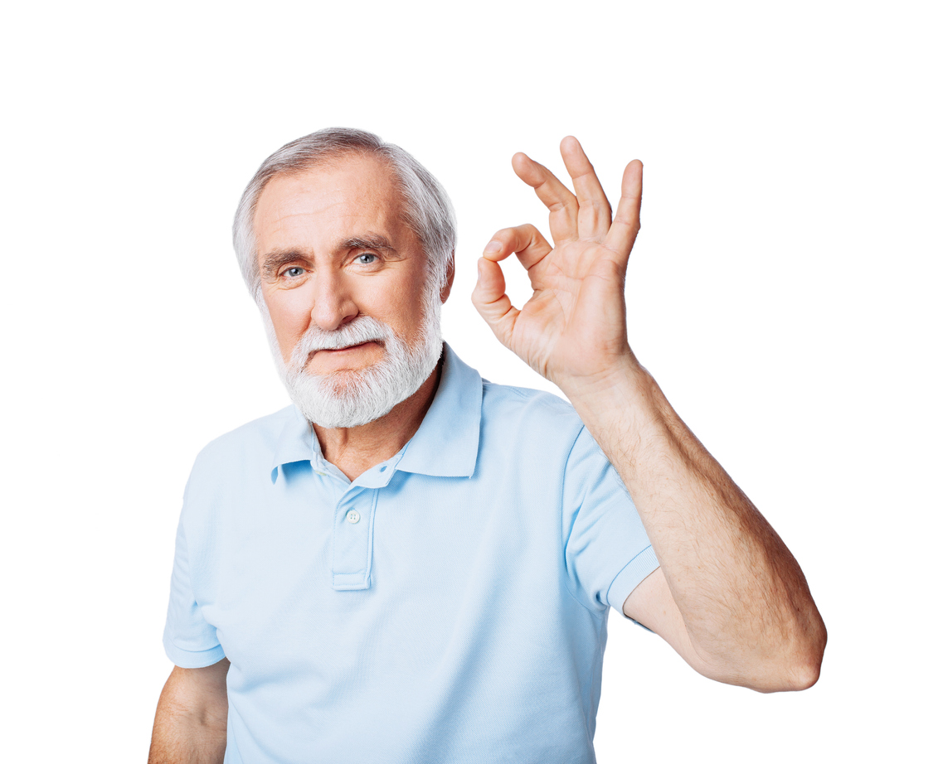
Healthy Self-Esteem Checklist
A healthy self-esteem acknowledges both your abilities and limitations. Consider the following checklist and select the statements that apply to you.
I'm growing and learning
I have many talents and positive traits
I am wanted by others
Other people value me

Slide 36
Healthy Self-Esteem Checklist
A healthy self-esteem acknowledges both your abilities and limitations. Consider the following checklist and select the statements that apply to you.
I can make contributions to others
I enjoy life
I'm helpful to others
I can receive and believe compliments from others

Slide 37
Healthy Self-Esteem Checklist
A healthy self-esteem acknowledges both your abilities and limitations. Consider the following checklist and select the statements that apply to you.
I’m proud of the character traits I have
I feel confident
I don’t really worry about making mistakes
I can be courageous, brave, and bold

Slide 38
Healthy Self-Esteem Checklist
A healthy self-esteem acknowledges both your abilities and limitations. Consider the following checklist and select the statements that apply to you.
I'm able to state my opinion
My life has purpose and meaning
I can make decisions and feel comfortable with them
I feel comfortable around others

Slide 39
Healthy Self-Esteem Checklist
A healthy self-esteem acknowledges both your abilities and limitations. Consider the following checklist and select the statements that apply to you.
My mind is peaceful
I am, for the most part, content
I don’t worry what others might think of me
I can ask for what I need

Slide 40
Healthy Self-Esteem Checklist
A healthy self-esteem acknowledges both your abilities and limitations. Consider the following checklist and select the statements that apply to you.
My needs are as important as others
I have abilities and skills
I can look at others directly and with confidence

Slide 41

People with low self-esteem use very specific criteria to determine their worth, competence, and adequacy. They review past mistakes, disappointments, and failures as the measurement to prove their inferiority.

Slide 42
Minimizing faults and highlighting strengths and positive characteristics is a skill that can be developed. Doing this will build confidence, improve mood, and build inner strength.

Slide 43
Consistent review, alongside a strong belief, of these positive traits and qualities can help bring a healthier view of self and provide encouragement when bad days come along.

Slide 44

Focus on Positive Qualities
Most people have numerous positive qualities but too often minimize or overlook them.

Slide 45

Read the following list and check the traits that apply to you:
Balanced
Blessed
Boundless
Brave
Bright
Calm
Capable
Caring
Charming
Cheerful
Accepting
Adaptable
Adventurous
Agreeable
Alert
Ambitious
Amusing
Articulate
Assertive
Clever
Compassionate
Confident
Consistent
Content
Cooperative
Courageous
Creative
Cultured
Curious

Slide 46
Read the following list and check the traits that apply to you:
Decisive
Delightful
Detail-oriented
Determined
Diligent
Diplomatic
Disciplined
Driven
Eager
Easy-going
Efficient
Empathetic
Encouraging
Energetic
Entertaining
Enthusiastic
Excellent
Excited
Exuberant
Fair
Focused
Forgiving
Friendly
Full of life
Funny
Generous
Gentle
Genuine
Gracious
Growing

Slide 47
Read the following list and check the traits that apply to you:
Happy
Helpful
Hilarious
Honest
Honorable
Hopeful
Humble
Imaginative
Impartial
Industrious
Instinctive
Intelligent
Intuitive
Joyful
Kind-hearted
Knowledgeable
Learner
Level-headed
Likable
Lively
Lively
Loving
Loyal
Mature
Mindful
Modern
Motivated
Nice
Nurturing
Observant

Slide 48
Read the following list and check the traits that apply to you:
Open-minded
Optimistic
Organized
Outgoing
Passionate
Patient
Peaceful
Persevering
Persistent
Persuasive
Pleasant
Positive
Productive
Protective
Proud
Punctual
Quiet-minded
Receptive
Reflective
Relaxed
Resilient
Resolute
Resourceful
Respectful
Responsible
Romantic
Satisfied
Selective
Self-assured
Self-aware

Slide 49
Read the following list and check the traits that apply to you:
Self-controlled
Sensitive
Silly
Sincere
Skillful
Spiritual
Steadfast
Successful
Supportive
Sympathetic
Talented
Teachable
Thoughtful
Thrifty
Trusting
Trustworthy
Unbiased
Understanding
Unique
Upbeat
Virtuous
Vivacious
Warm
Wise
Witty
Wonderful
Young at heart
Youthful
Zealous

Slide 50
What did you learn about yourself?

Slide 51
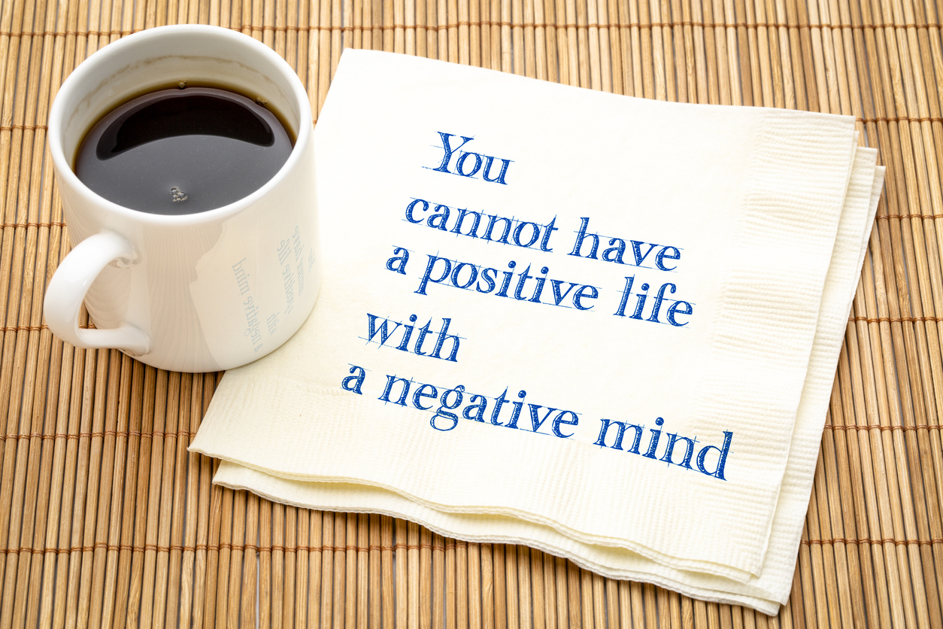
Ten ways to increase self-esteem
1. Identify and replace your negative self-talk.
People with low self-esteem often put themselves down or even call themselves names. Practice speaking positively to yourself, about yourself, to increase self-confidence.

Slide 52

Ten ways to increase self-esteem
2. Review positive attributes about yourself.
Write a list of the positive characteristics, attitudes, personality traits, and attributes you possess. Regular review will increase your self-esteem and act as a defense against your negative self-talk.

Slide 53

Ten ways to increase self-esteem
3. Set character goals
Set a goal to be kind, loving, understanding, or patient. Rather than comparing your appearance, performance, wealth, or social standing against your friends or family members, compare yourself with your own character goals.

Slide 54

Ten ways to increase self-esteem
4. Highlight and review victories.
Minimize setbacks and failures. To increase a positive sense of self, it is helpful to highlight progress and improvements and spend your time focusing on these things. Maximize success and minimize your struggles.

Slide 55
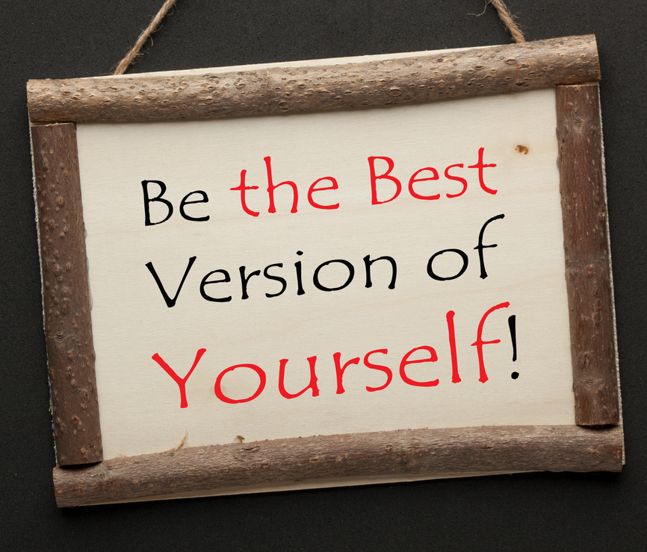
Ten ways to increase self-esteem
5. Focus on the things you can change
Many people spend too much time focusing on situations, circumstances, other people’s feelings toward them, and any number of issues outside their control. Time is better spent focusing on the character goals you set. You are the one who controls your mood, attitude, and disposition, so focus on these things.

Slide 56
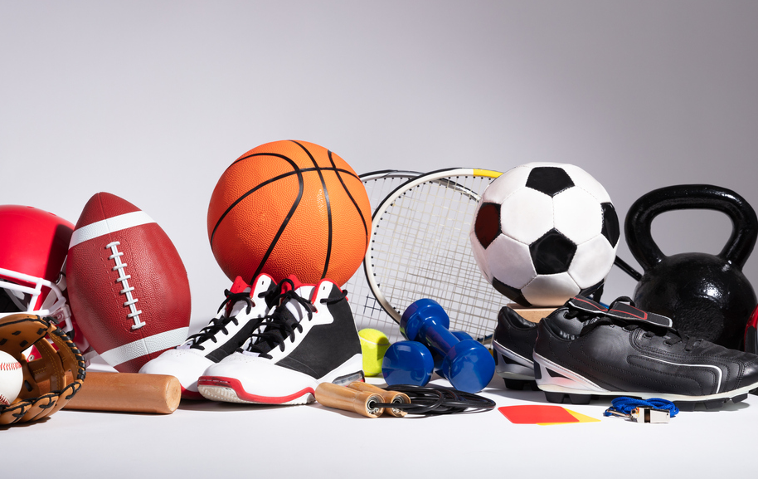
Ten ways to increase self-esteem
7. Increase exercise.
Endorphins are the body’s natural anti-depressant, and adding activity and exercise to your life can boost endorphin production. Daily exercise can energize you, improve your mood, make it easier to interact with others, and help you feel better about yourself.

Slide 57
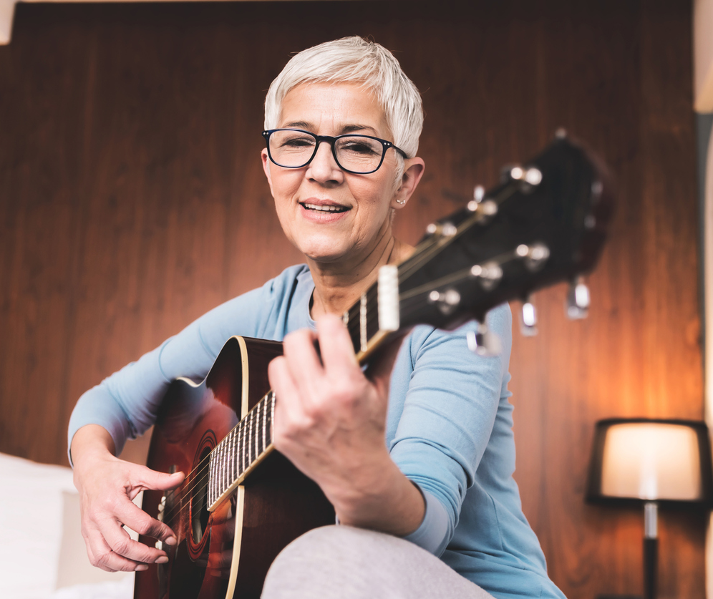
Ten ways to increase self-esteem
8. Add hobbies, interests, and activities.
Schedule some time for relaxation, fun, and entertainment. Anxiety and worry rob you of the simple pleasures in life. Give yourself permission to enjoy the wide variety of experiences and opportunities life offers. This can increase your positive outlook and keep you from feeling deprived.

Slide 58

Ten ways to increase self-esteem
9. Do something nice for someone and don’t tell anyone about it.
Helping someone else can increase positive feelings about yourself.

Slide 59

Ten ways to increase self-esteem
10. Increase your independence.
Self-esteem is often increased as you do more to improve your own situation. As you become more responsible for your own mood, you will become less dependent on others to help you feel good about yourself.

Slide 60
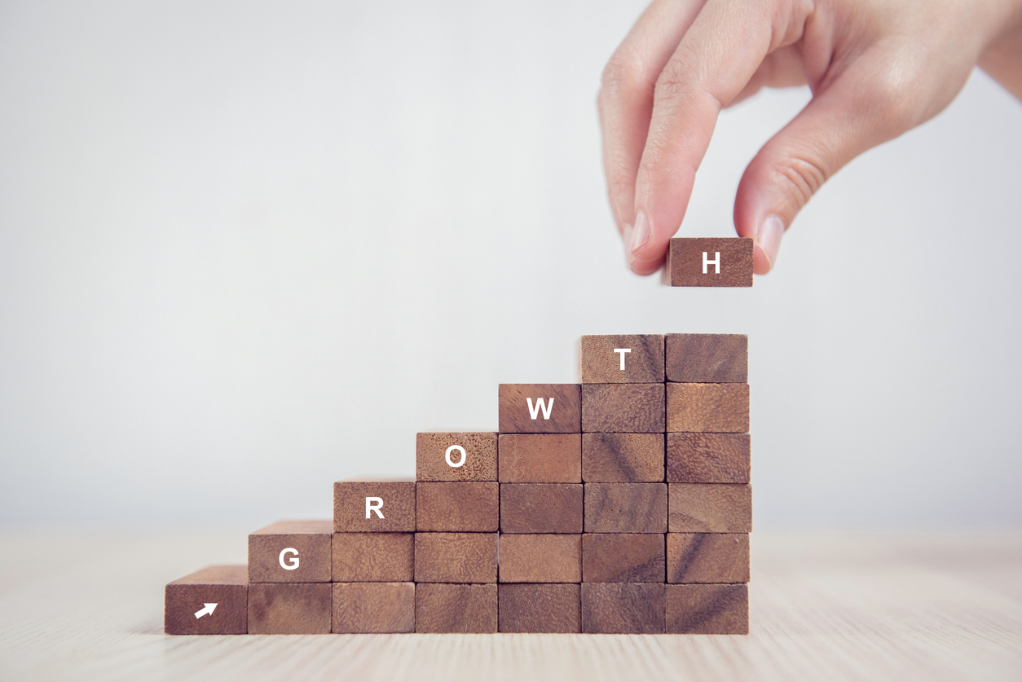
CHANGE FOLLOWS ACCEPTANCE
It is not difficult to see how co-occurring disorders and low self-esteem go hand in hand, and how a healthy self-esteem goes along with solid recovery. Changing yourself because you dislike yourself is not effective motivation.

Slide 61
CHANGE FOLLOWS ACCEPTANCE
You can accept and like yourself the way you are and use that acceptance as a platform and foundation to change yourself for the better. Learning to like and believe in yourself is a process and it has many rewards for your recovery and beyond.

Slide 62
Recovery is a Journey. Enjoy the Ride!
Thank you for watching today’s presentation. For more mental health and substance abuse resources, visit our website at JourneyToRecovery.com.

Slide 63
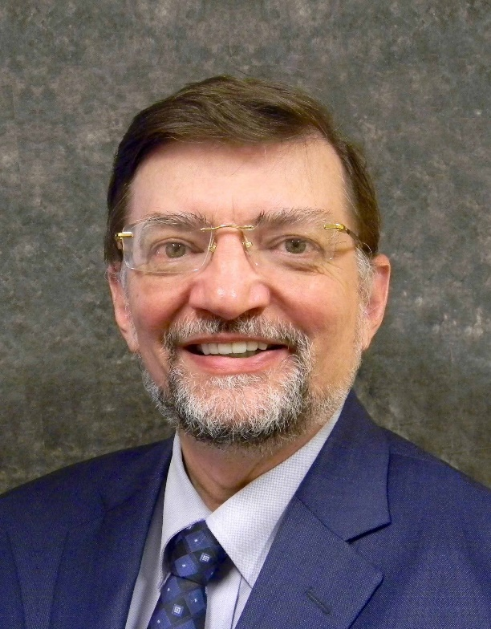
About the Author
Dr. Hal Baumchen is a clinical psychologist, a licensed alcohol and drug counselor and Co-Occurring Disorder Specialist. During the past 30 years of clinical work he has developed an interest, passion and expertise in the diagnosis and treatment of co-occurring disorders.

Slide 64
About the Author
Dr. Hal Baumchen is the founder and creator of the Journey to Recovery resources. Our materials are designed as a tool kit to aid in your treatment of mental health and substance use issues. The various topics will help you recognize destructive patterns, change your thinking, and develop specific positive life skills.

